Slide 1

ML in Applications
Dipartimento di Automatica e Informatica
Politecnico di Torino, Torino, ITALY

Slide 2
DINO: Emerging Properties in Self-Supervised Vision Transformers

Slide 3
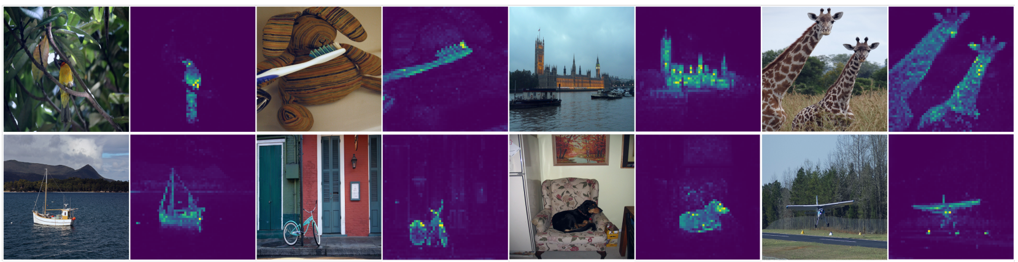
What is DINO
DINO is a non contrastive self supervised technique. This type of technique is useful for pretraining.
Reference: https://arxiv.org/abs/2104.14294
Slide credit: L. Lazebnik

Slide 4
What is DINO
It’s a framework based on two models, a teacher and a student. The teacher is fed big crops from the original image while the student is fed small crops. The student must learn to predict the global embedding from the small crop.
Reference: https://arxiv.org/abs/2104.14294
Slide credit: L. Lazebnik

Slide 5
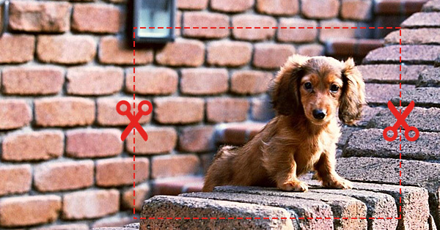
Multi cropping
Global crops are >50% of the whole
Local crops are <50%
The original paper uses 224x224 global crops and 96x96 local crops

Slide 6
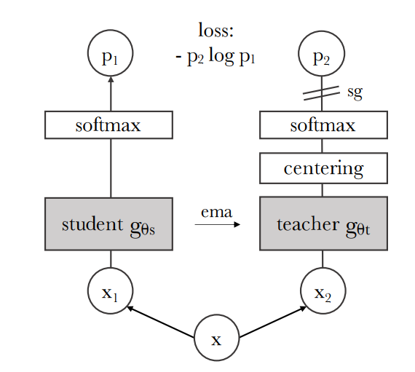
How it works

Slide 7
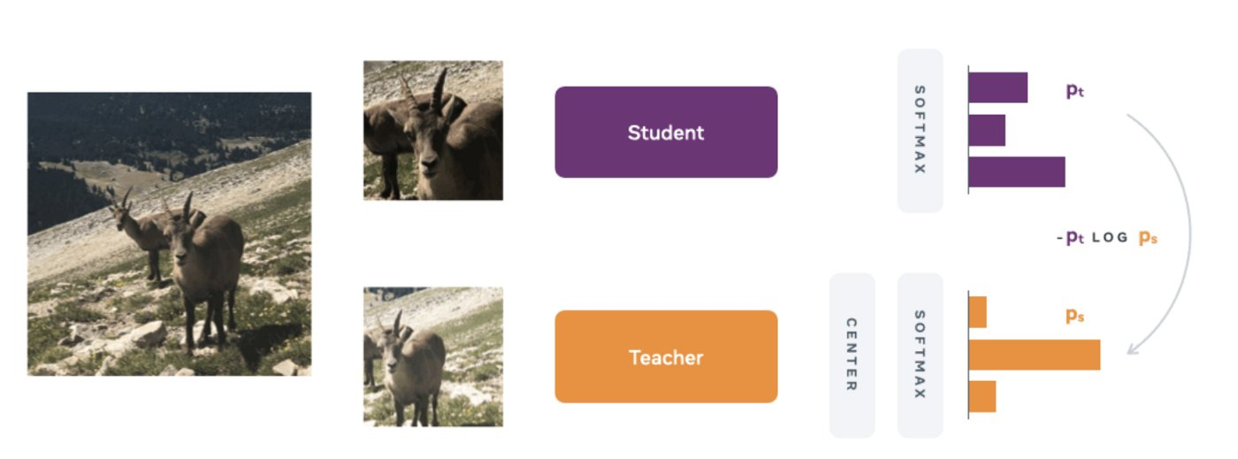
How it works

Slide 8
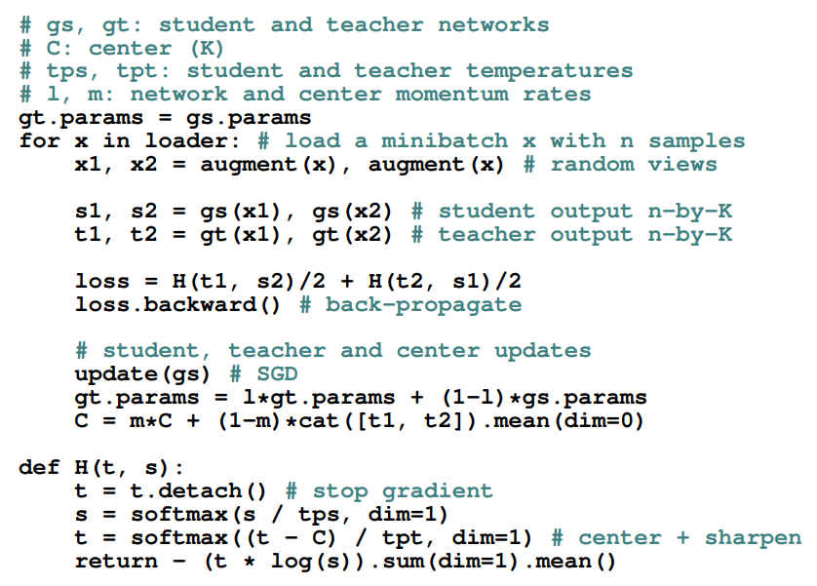
Pseudo code
Pseudo code is missing multi-crops

Slide 9
Today’s LAB
Today’s ipynb has some guiding code.
Write your own implementation of the DINO algorithm
You can use the pseudo-code to guide you

